Slide 1
UNIT – III POLITICAL SCIENCE DEMOCRATIC POLITICS- IX CHAPTER- WHAT IS DEMOCRACY? WHY DEMOCRACY?
BY
MS SWAPNA PANIGRAH
MS MINATI PATNAIKI

Slide 2
Simple Definition of Democracy
Democracy is a form of Government in which the rulers are elected by the people

Slide 3
WHAT IS DEMOCRACY?
Features of Democracy:-
It is a form of Government in which rulers are elected by the people.
In a Democracy final decision rest with the leaders elected by the people.
Democracy must be based on free and fair election.
A democratic Govt. rulers within the limits set by the constitutional law and citizen’s rights.

Slide 4
Pakistan a Democracy?
In 1999 , A military General Pervez Musharaf took over the government.
In 2002, he changed the designation to President, also held a referendum that granted him 5 years of extension.
In 2002, he issued a legal frame work, according to which he amended the constitution. It gave the President the right to dismiss the national/provincial assemblies.
The work of civilian cabinet was supervised by a national security council. Which was dominated by the military. After the law was passed elections were held in the assemblies.
Therefore there were elected representatives that had some power. But the final power was under the military and General Musharraf

Slide 5
OUT COMES
The representatives elected by the people were not the real rulers.
The main power rested under General Musharraf.
He forced himself as the president on the people.
Therefore Pakistan could not be called as a democracy.

Slide 6
IS ZIMBABWE A DEMOCRACY?
Zimbabwe gained Independence in the year 1980. since then the country had been ruled by the party ZANU-PF . This party led the freedom struggle in the leadership of Robert Mugabe.
Since then , the elections had held at a regular pace and won by ZANU-PF.
President Mugabe is popular but also uses unfair practices in elections. Over the years this govt. has changed the constitutions several times to increase his powers and less accountability
The opposition party workers were harassed and their meetings were disrupted .public demonstration against the govt was illegal.
Television and radio are controlled by govt

Slide 7
OUTCOMES
The approval of the rulers is necessary in a Democracy but not sufficient.

Slide 8
WHY DEMOCRACY?
Arguments against democracy
Arguments in favour of democracy
Leaders keep changing, leads to instability.
It is all about competition and power play. No scope for morality.
Many people have to be consulted, delays decisions.
Elected leaders do not know the best interest of the people. Leads to bad decisions.
Democracy leads to corruption as it is based on electoral competition.
Democratic government more accountable and better.
It improves quality of decisions making.
It provides method to deal with differences and conflicts.
It enhances the dignity of citizens.
Democracy allows us to correct our mistakes.

Slide 9
BROADER MEANINGS OF DEMOCRACY
REPRESENTATIVE DEMOCRACY
The most common form of democracy in modern times is Representatives democracy.
Leaders are elected by the adult citizens.
Majority is allowed to take decisions on behalf of the people.
SIGNIFICANCE OF REPRESENTATIVE DEMOCRACY
Modern democracies have such large number of citizens that it is not possible for all to sit together and take decision collectively.
Even if possible, the citizens do not have the time, the desire or the skills to take part in all the decisions.

Slide 10
ACTIVITY
Find out the total number of eligible voters in your assembly constituency Find out how many people can fit into the largest stadium in your area. Is it possible for all the voters in your assembly constituency to sit together and have a meaningful discussion?

Slide 11
DISTINGUISH BETWEEN DEMOCRACY AND NON DEMOCRACIES
DEMOCRACY
NON-DEMOCRATIC
Government elected by the adult citizens.
Citizens have the fundamental rights.
Leaders rule within the constitutional laws and citizens’ rights.
There are regular election.
The Govt. work within the constitution.
Parliament is supreme.
Accountability is present.
For Ex- India.
Government is not elected. It is either a dictatorship or monarchy.
No rights to the citizens.
Leaders rule as they feel like.
Election is not regular.
Non democratic Govt. can change its constitution according to the wishes of the ruler.
Ruler is supreme.
No accountability.
For Ex-Saudi Arabia.

Slide 12
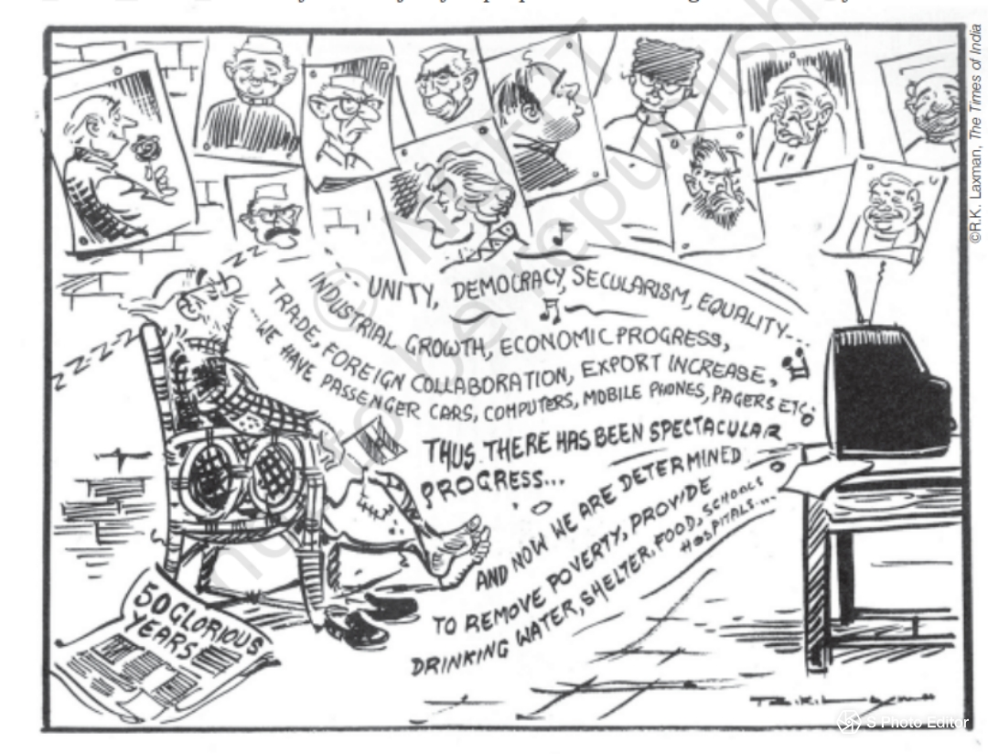
ACTIVITY This famous cartoon by R.K.Laxman comments on the celebrations of the fifty years of Independence. How many images on the wall do you recognise write their names.

Slide 13
Answer the following questions.
Q.1 Define the term Democracy.
Q.2 Who led a military coup in Pakistan in 1999?
Q.3 Write one feature of Democracy.
Q.4 Give an argument against Democracy.
Q.5 Write one merit of Democratic government.
Q.6 Name the most common form of Democracy of modern time.
Q.7 Why do we prefer representative democracy?

Slide 14
D.A.V. PUBLIC SCHOOL, BERHAMPUR
THANK YOU

